Slide 1
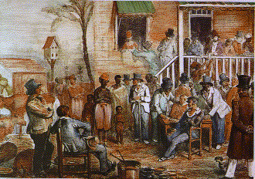
Oroonoko; or, The Royal Slave

Slide 2
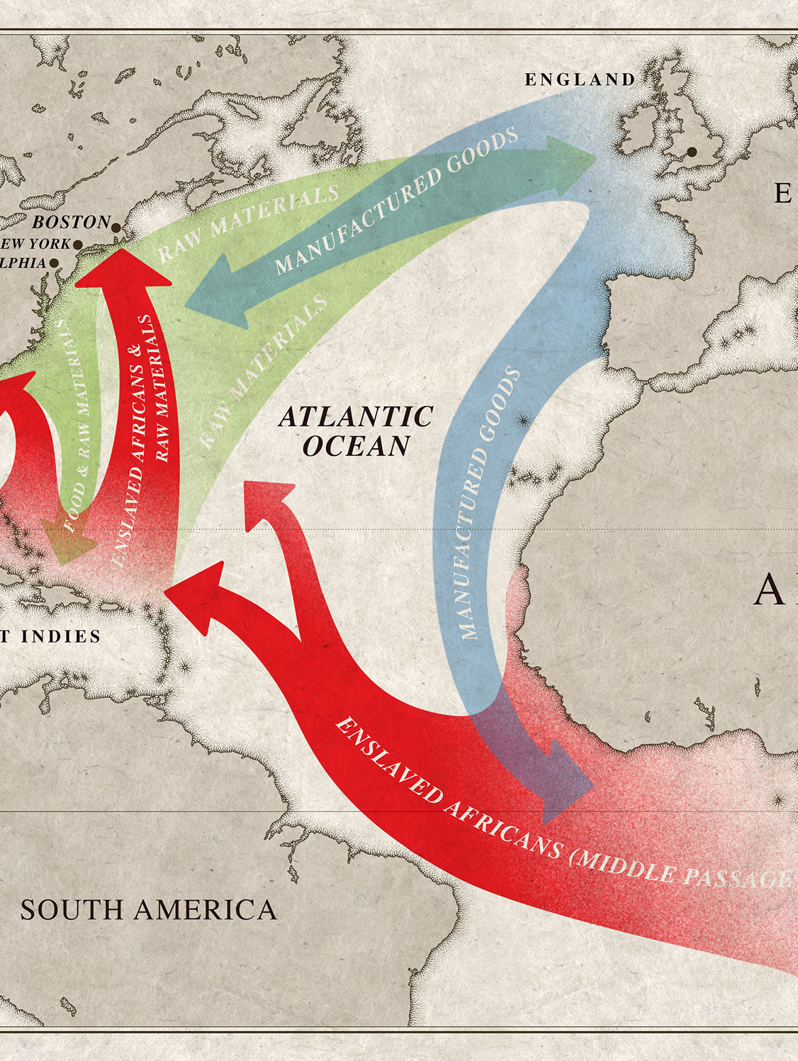
Transatlantic Slave Trade
The TST began in the 1480s with Portuguese and Spanish merchants
Dutch became lead slave-merchants in 1600s
By the 18th century, England controlled over half of the TST—and over half of all enslaved Africans took place in the 18th century

Slide 3
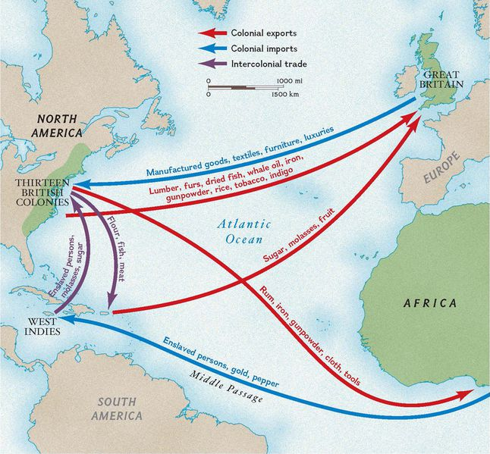
Colonial Empire
The British Empire really became the British Empire in the 18th century, due in large part to imperial colonialism and slavery
12–15 million Africans were kidnapped, enslaved, and sent to the Americas (over half in the 18th century alone)
West Africa was the main area/target
This is also when the concept of “race” was developed – separate from national identity/tribal groups

Slide 4
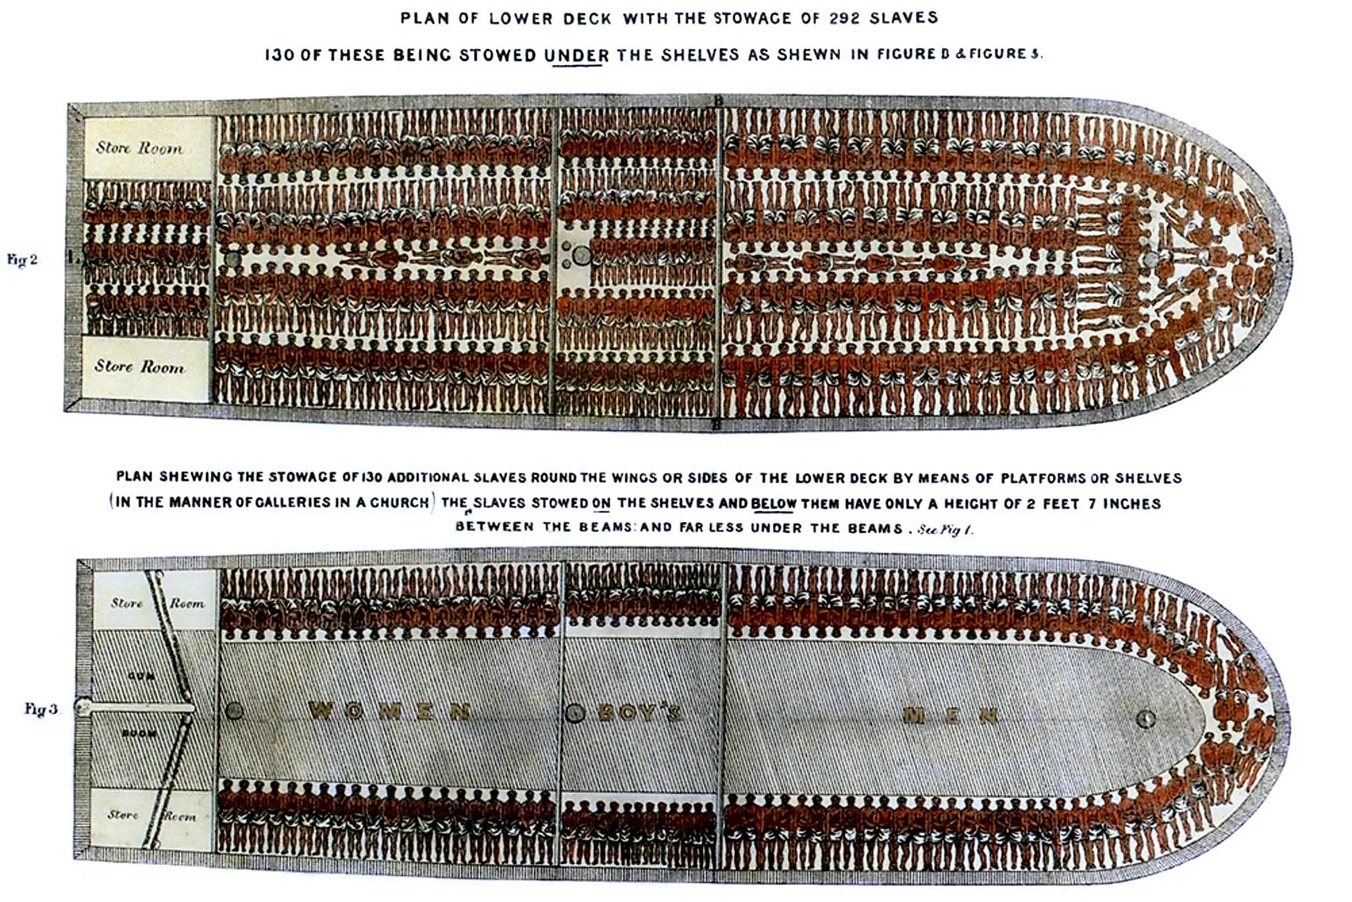
The Middle Passage

Slide 5
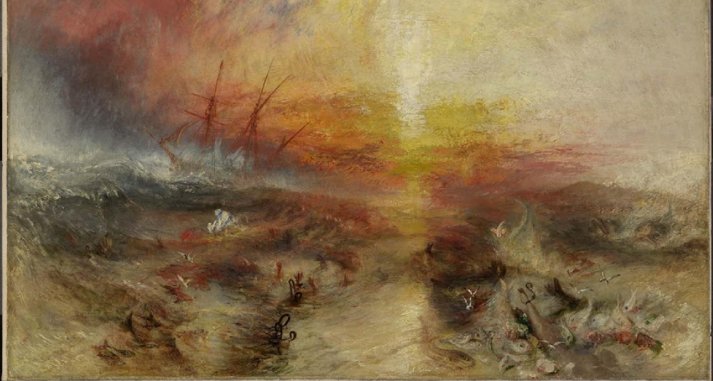
J.M.W. Turner, The Slave Ship

Slide 6
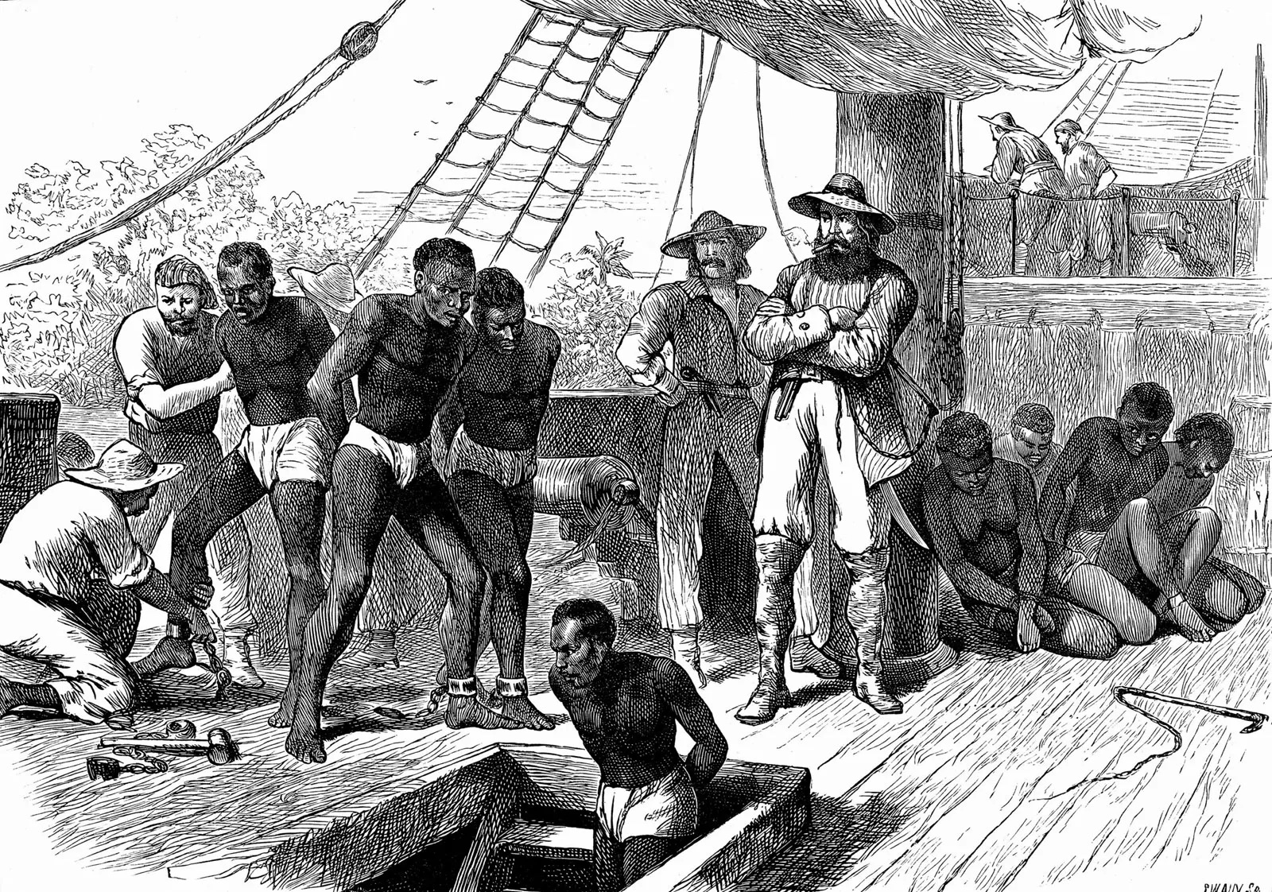
African vs. European Slavery
Slavery had existed for thousands of years, and it was common in Africa for warring tribes and ethnic groups to enslave those they defeated/captured
Some big differences:
  Children of slaves in Africa were free; in America, slavery was hereditary
  Europeans shipped slaves across the world, while African slaves stayed in the same region
  Europeans commercialized slavery with the transatlantic slave trade – it was Big Business

Slide 7
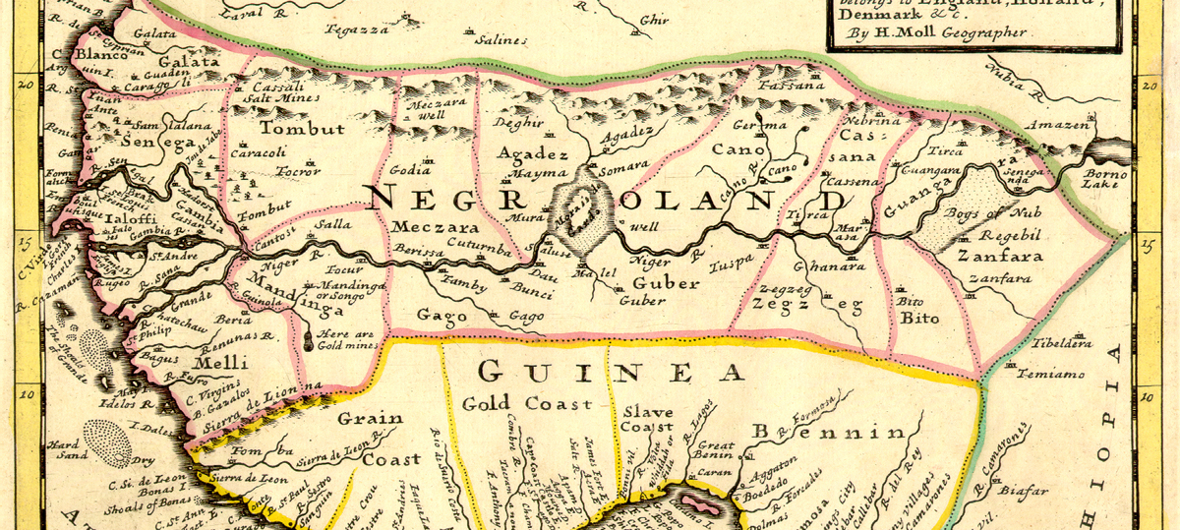
West Africa in the 18th century
Europeans renamed nations after major export (grain, gold, slaves, ivory)
Above area now the countries of Guinea, Sierra Leone, Liberia, Ghana, and Nigeria (among many others)

Slide 8
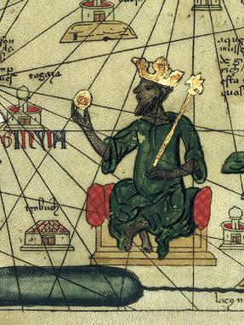
West Africa pre-colonialism
Great empires stretching back to 1600 BCE
An area rich with natural resources (like gold) and cultural sophistication
European colonialism destroyed and disrupted these cultures and their families
Most countries remained under European control until the 1970s; many have struggled to rebuild since then (postcolonial legacy)

Slide 9
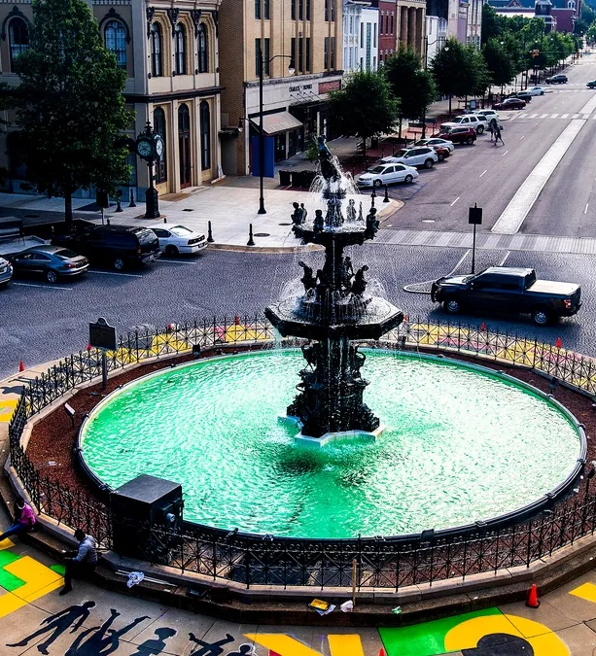
TST and Alabama/Deep South
Charleston, South Carolina: America’s major slave trading port in the 18th century
New Orleans, Louisiana: America’s major slave trading port in the 19th century
Slave traders chained slaves together and marched them hundreds of miles to various destinations, including Montgomery (later, it was by railway or steamboat)
Slave “pens” lined Commerce Street in the 19th century, with Alabama’s largest slave market at Court Square Fountain

Slide 10
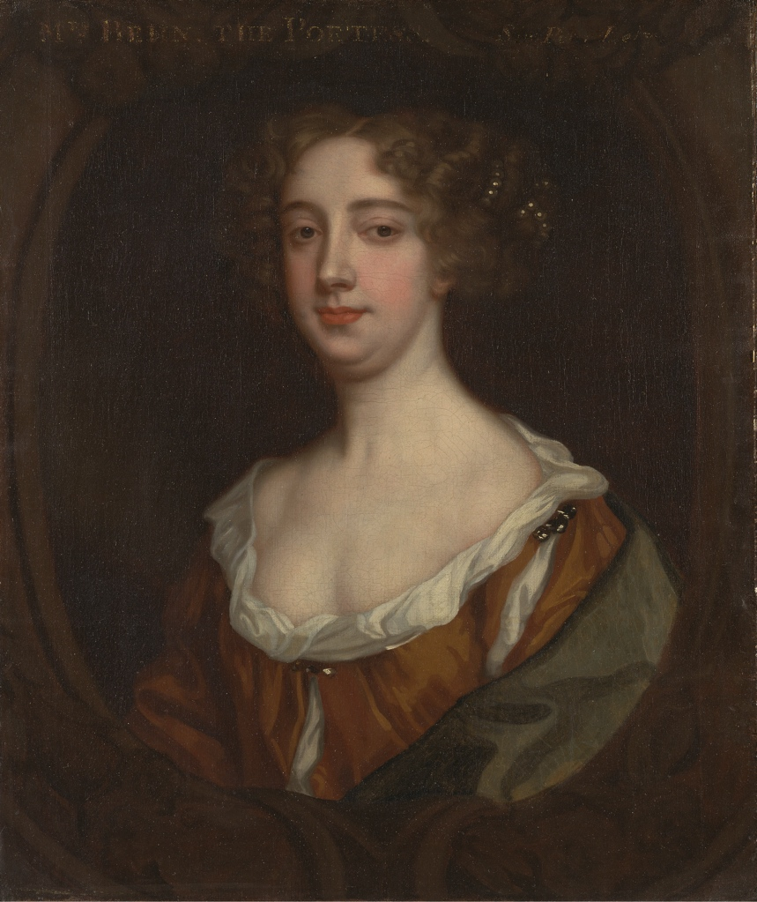
Aphra Behn (1640–1689)
Prolific and successful author
  First professional woman writer in England
Family and Life
  Lived in Suriname (British colony in South America)
  Husband was merchant
  Spy for King in Antwerp
  Early figure of women’s rights
  Witty conversationalist
Known primarily for Oroonoko

Slide 11
Diversity Essay
(next “big” paper)
500-word essay on representation of “diversity” in one of our readings
  race, gender, class, sexuality, disability, and/or ethnicity
Personal reflection: different from or related to your own experiences – what did you learn?
Analysis/Close Reading: how does the representation of diversity work in the reading?
Historical context: importance of time period in which it was written – how does the historical context impact the representation of diversity?

Slide 12
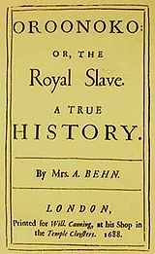
Oroonoko (1688)
Slave narratives played important role in the history and development of the novel
  Narrator in opening lines claims the story is “true,” but Behn’s “eyewitness” accounts of slavery only inform some of the novel; it is not “A True History”
Genres: slave narrative; travel narrative; adventure story; global narrative; tragedy; political allegory; early abolitionist argument
Adapted into popular play in 1695 by Thomas Southerne
Behn’s contemporary readers/viewers saw the story as an heroic tragedy; later 19th-centry readers saw it as much more sentimental/emotional and took it up as part of abolitionist movement

Slide 13
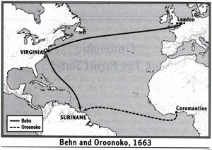
A Global Narrative
Global interactions of the modern world – first English story to do so
Three Worlds
  England: polite, artificial, commercial home
  Africa: perpetual war, vast numbers of slaves
  America: the “New World” full of welcoming natives, plentiful food…and plantations

Slide 14
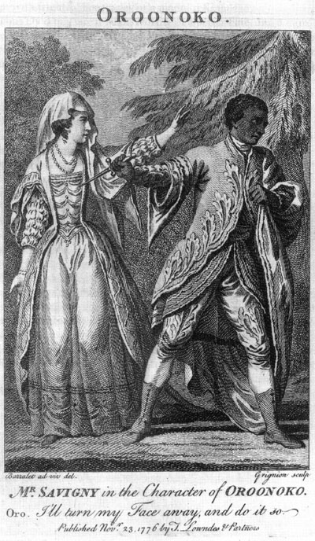
Oroonoko
Narrator’s opening frame
  “This is a true story” (37)
  Natives and slaves (39–41)
  Oroonoko (42–44)
Oroonoko in Africa
  Imoinda
  Battle heroics (61)
  Tricked by slave trader
Oroonoko in Surinam
  Ceasar and Clemene (72)
  Heroics in the jungle (78–80)
  The native Indians (82–84)
  Battle speech (86–87)
  Treachery and brutality (91)
  Tragic conclusion

