Slide 1
William Shakespeare
A brief biography

Slide 2
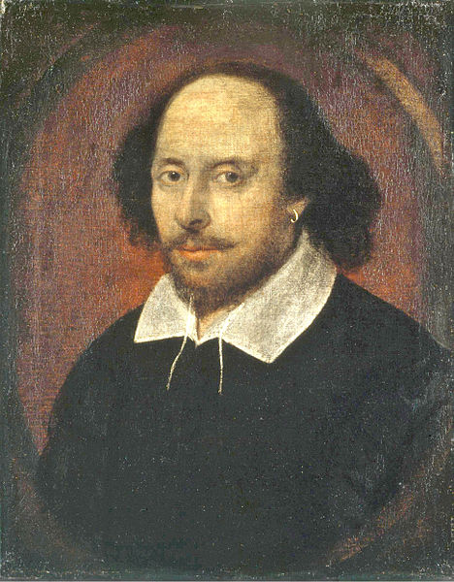
William Shakespeare (1564–1616)
Born in Stratford-upon-Avon to emergent middle-class family
Married Anne Hathaway in 1582, had three children
  Not considered a happy marriage
  Moved to London for his career
  Lived through multiple “plague years”
Established success as playwright by 1592, known as the best throughout the 1590s and 1600s
  Information we know about Shakespeare comes from legal documents, business transactions, and others’ comments
The “King’s Men”
  Shakespeare developed his own company and theatre—this was atypical for the time
  Elizabethan playwrights were competitive and collaborative—and he was at the top

Slide 3
The Many Plays of Shakespeare
The Two Gentleman of Verona (1591)
The Taming of the Shrew (1591)
Henry VI (1591-2)
Titus Andronicus (1592)
Richard III (1593)
Edward III (1593)
The Comedy of Errors (1594)
Love’s Labours Lost (1595)
Love’s Labours Won (1596)
Richard II (1595)
Romeo and Juliet (1595)
A Midsummer Night’s Dream (1595)
King John (1596)
The Merchant of Venice (1597)
Henry IV (1597-8)
The Merry Wives of Windsor (1597)
Much Ado About Nothing (1599)
Henry V (1599)
Julius Caesar (1599)
As You Like It (1600)
Hamlet (1601)
Twelfth Night (1601)
Troilus and Cressida (1602)
Sir Thomas More (1604)
Measure for Measure (1604)
Othello (1604)
All’s Well That Ends Well (1605)
King Lear (1606)
Timon of Athens (1606)
Macbeth (1606)
Antony and Cleopatra (1606)
Pericles, Prince of Tyre (1608)
Coriolanus (1608)
Cymbeline (1610)
The Winter’s Tale (1611)
The Tempest (1611)
Cardenio (1613)
Henry VIII (1613)
The Two Noble Kinsmen (1614)
* Plays typically grouped by genre rather than dates: Comedies, Histories, and Tragedies

Slide 4
Publications and the Problem of the Text
1593: Venus and Adonis
  narrative poem: Shakespeare’s first publication
1594: The Rape of Lucrece
  narrative poem: classical, like first poem
1601: The Phoenix and the Turtle
  bizarre and hotly-debated narrative poem
1609: Sonnets and A Lover’s Complaint
  series of 154 sonnets, most of which had been written and circulated in the 1590s
1623: First Folio
  collection of 36 plays published and edited posthumously

Slide 5
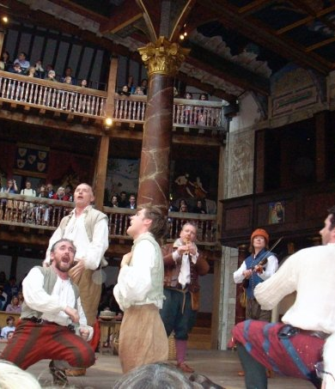
The Theatrical World
Public playhouses developed in 1560s and 70s
  10% of population attended theatre regularly: major source of entertainment
Actors were considered vagabonds and had no social/political respectability—but some had fame
  For fear of prosecution, they would attach themselves to a patron
  All actors were men
  Shakespeare also performed in his plays
Class Considerations
  All classes came to theatre: the lower classes stood in the “pit” and the upper classes had nice seats in the balcony
  Riotous, noisy crowds
  Potential for dangerous politics

Slide 6
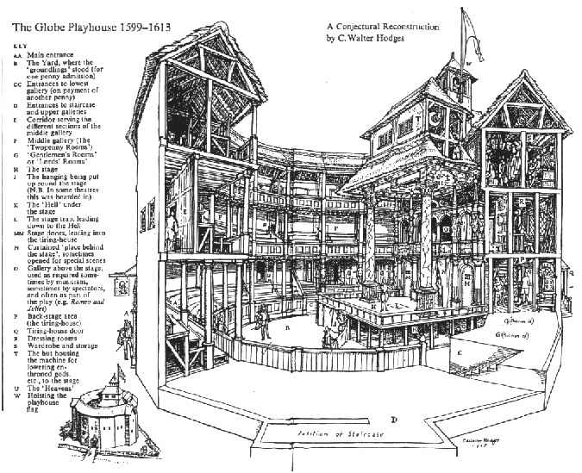
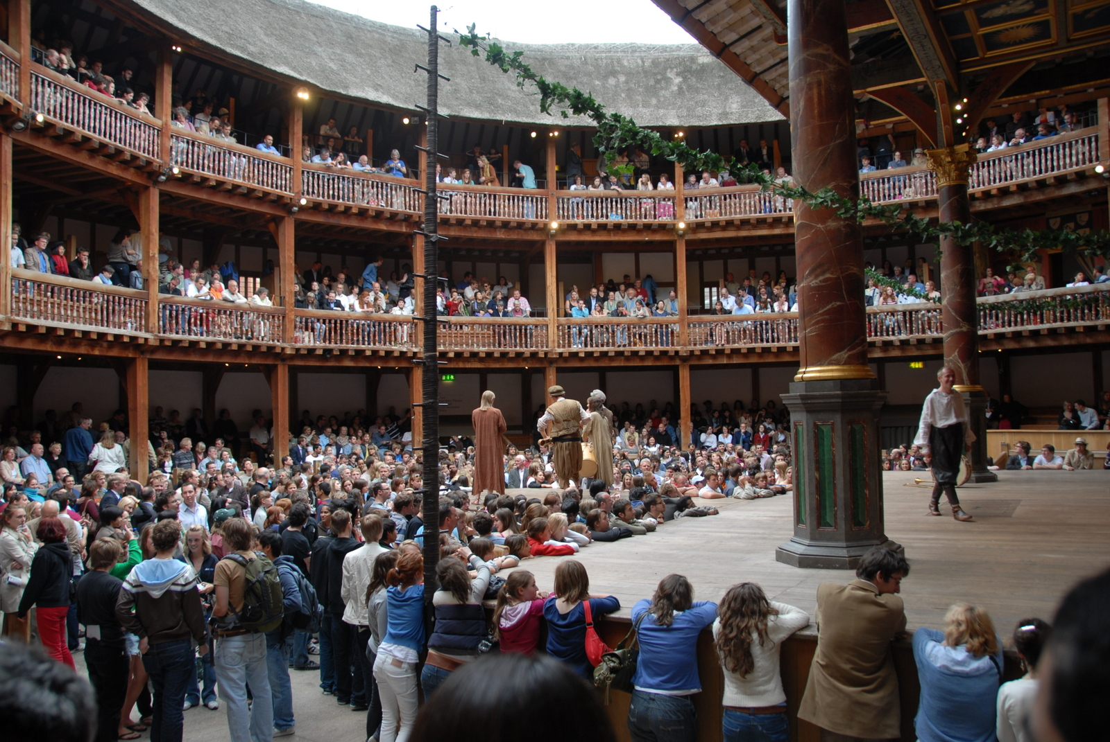
The Globe Theatre

Slide 7
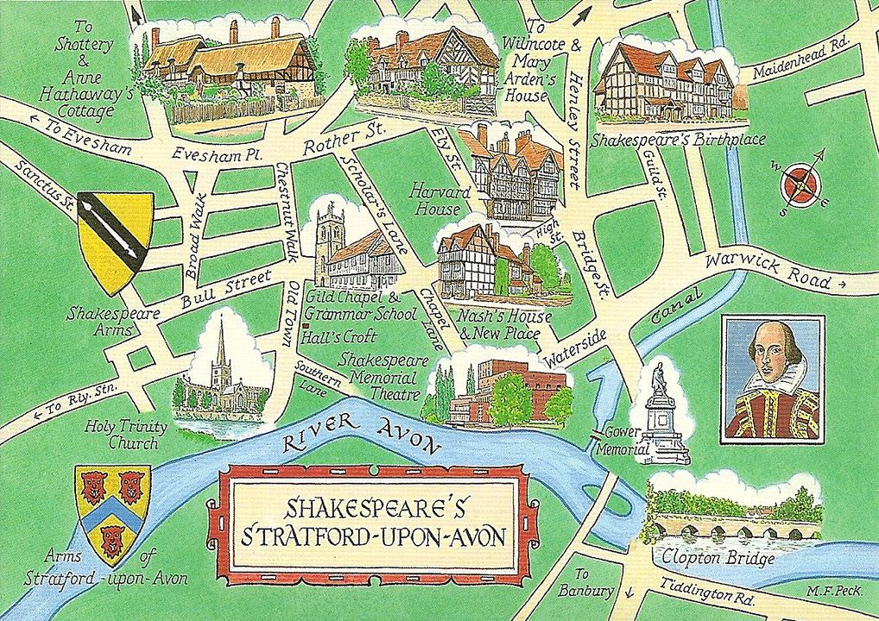
Shakespeare: Global Literary Celebrity
Eighteenth-century Bardolotry
  While Shakespeare was a popular playwright during the Renaissance, he didn’t achieve celebrity status until the eighteenth century
  English canon
1769: Shakespeare Jubilee
  Mark of the Bard’s rising popularity, which only increased
Stratford-upon-Avon
  center of Shakespeare tourism
  Royal Shakespeare Company
Globe Theatre in London
  built in 1599
  burnt/rebuilt in 1613
  destroyed in 1645 for housing
  rebuilt in 1997 (about 200 yards from original site); part of London tourism

Slide 8
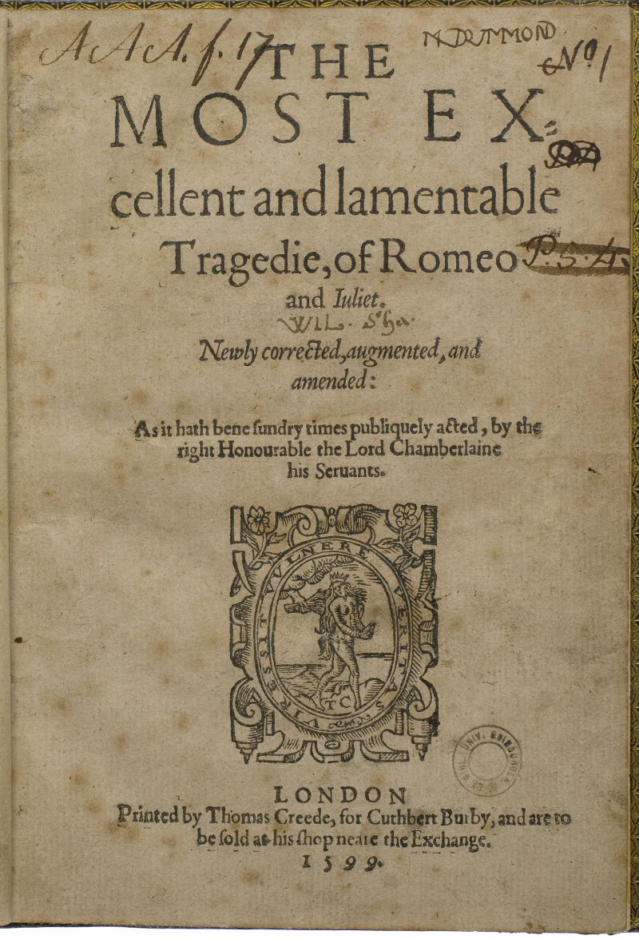
Composition and Sources
Story originated in Italian novelles in the 1400s
  First English translation in 1562
  Shakespeare first to turn it into a play
Shakespeare’s additions
  Action from a few months to four days
  Elevation of minor characters
  Misread notes and messages
  Emphasis on inner emotional states
  Several new scenes
Sonnets
  Shakespeare was writing sonnets and love poetry leading up to the play
  Several sonnets throughout play
  Play externalizes the drama and emotional intensity of the sonnet form: lover and beloved
  First playwright to do this

Slide 9
Major Themes and Elements
Formal Elements
Themes
Genre: Love Tragedy
  Comedic and tragic elements
  Five Acts: (1) Introduction; (2) Rising Action; (3) Climax; (4) Fall; (5) Catastrophe
Blank Verse
  Unrhymed iambic pentameter
  High/philosophical/serious
Sonnet Forms
  Actual sonnets in the play
  Couplets, quatrains, and sestets
Love
  tragic, noble, ideal, extreme
Violence
  ancient blood feuds
  inescapable nature of life
  paradoxically tied to love
Time
  suspension vs. speed
Youth
  rashness, intensity, and beauty of youth/youthful love

Slide 10
Prologue and First Scene
Prologue (a sonnet!)
  ancient feud and pattern of violence
  “star-cross’d lovers”
First scene: sets the stage, literally
  Shakespearean wordplay
  roaming gangs; hot summer; hatred boiling over into streets
  fusion of sex and violence
Romeo’s entrance (1.1.158–236)
  contrast with violence and action of the fight (time)
  speaks in couplets; he’s like a walking sonnet caricature

Slide 11
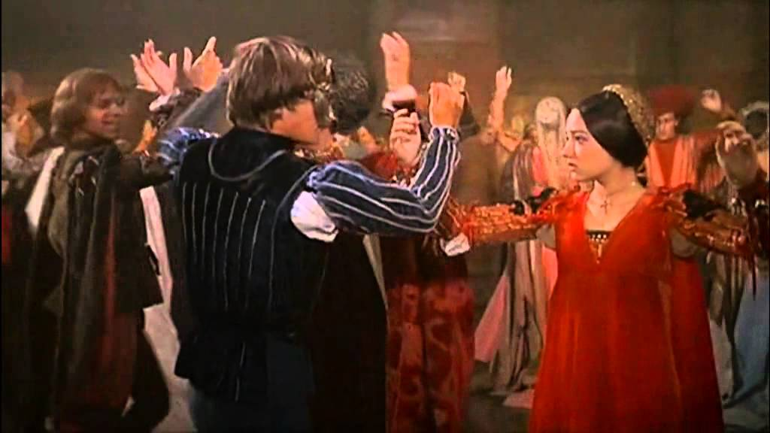
The Party – Love at First Sight
Mercutio’s speech (1.4.53–104)
  only character who is good with both families
  comedic and rash
Romeo sees Juliet (1.5.43–52)
  classic love at first sight
First conversation in sonnet form (1.5.92–105)
  trading lines/rhymes
  ends with kiss!

Slide 12
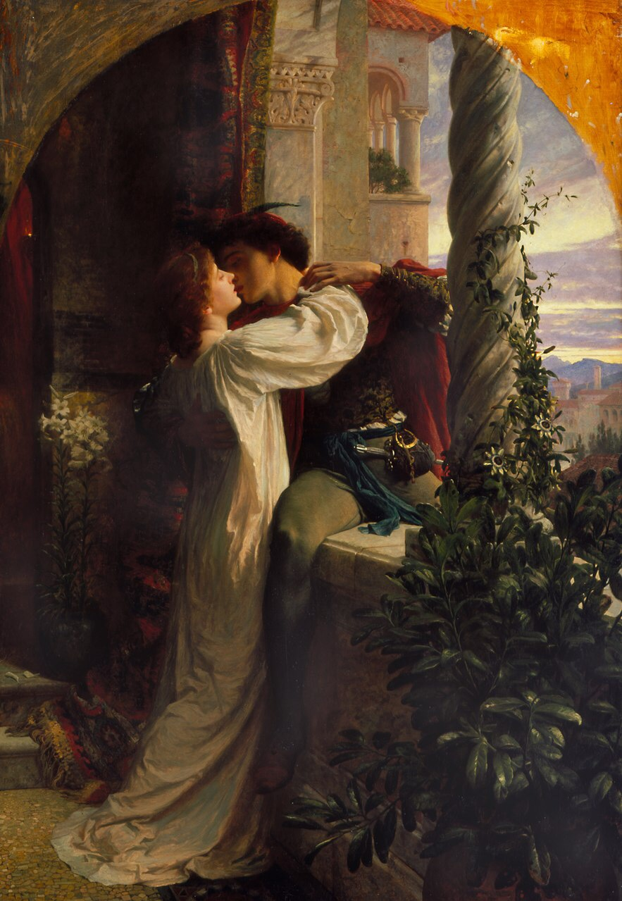
Act 2: Marriage!?
Act 2 Prologue (sonnet!)
Public party to private house/balcony
  monologues/soliloquies turn to conversation
  1996 version
  Entire second scene
Friar Laurence
  religion and medicine
  secret marriage plan
  advice to Romeo on loving moderately (2.6.9–15)

Slide 13
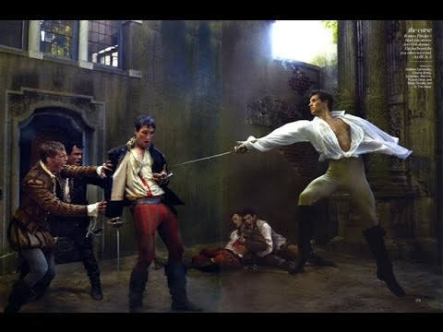
Act 3: Things Falling Apart
Mercutio’s murder (and Tybalt’s)
  lookin’ for a fight (3.1)
  Mercutio’s death
  Next scene
  lots o’ quibbles (minor objection and a pun)
  who is to blame?
Second balcony scene (3.5): stop sunrise
  Capulet’s rage (3.5.176–195)

Slide 14
Acts 4 and 5: Well, that Ended Badly
Act 4
Act 5
Speed of plot/time picks up very quickly
The Plot
  Juliet will fake her death
  Laurence will send Romeo note
  Laurence and Romeo will rescue Juliet when she awakens
Catastrophe
  Letter never reaches Romeo (5.2.)
  Romeo kills himself (after killing Paris – poor guy)
  Romeo’s final soliloquy (5.3.74–120)
  Juliet’s final soliloquy (5.3.161–168)

Slide 15
Final Scene: Lots o’ Bodies
Imagine the stage/scene and the bodies: Romeo, Juliet, Paris, and Tybalt; and off-stage, Mercutio and Lady Montague
Final sequence
  Complete silence as Romeo dies on Juliet’s breast
  Horror when Juliet awakens and commits suicide
  Two lovers, finally together, free from external pressures, frozen in time and youth, before the crowd that precipitated their deaths (golden statues as symbol of this)
Love Conquers All?
  Love ultimately unites families
  Love also represents the rashness and folly of youth

Slide 16
Question
Are we supposed to celebrate Romeo and Juliet, like the families do with the statues, as symbols of the power and passion of love? or Are we to read this story as a cautionary tale – “look what happens when you foolishly rush into love as a young kid and disobey your family?”

